Slide 1
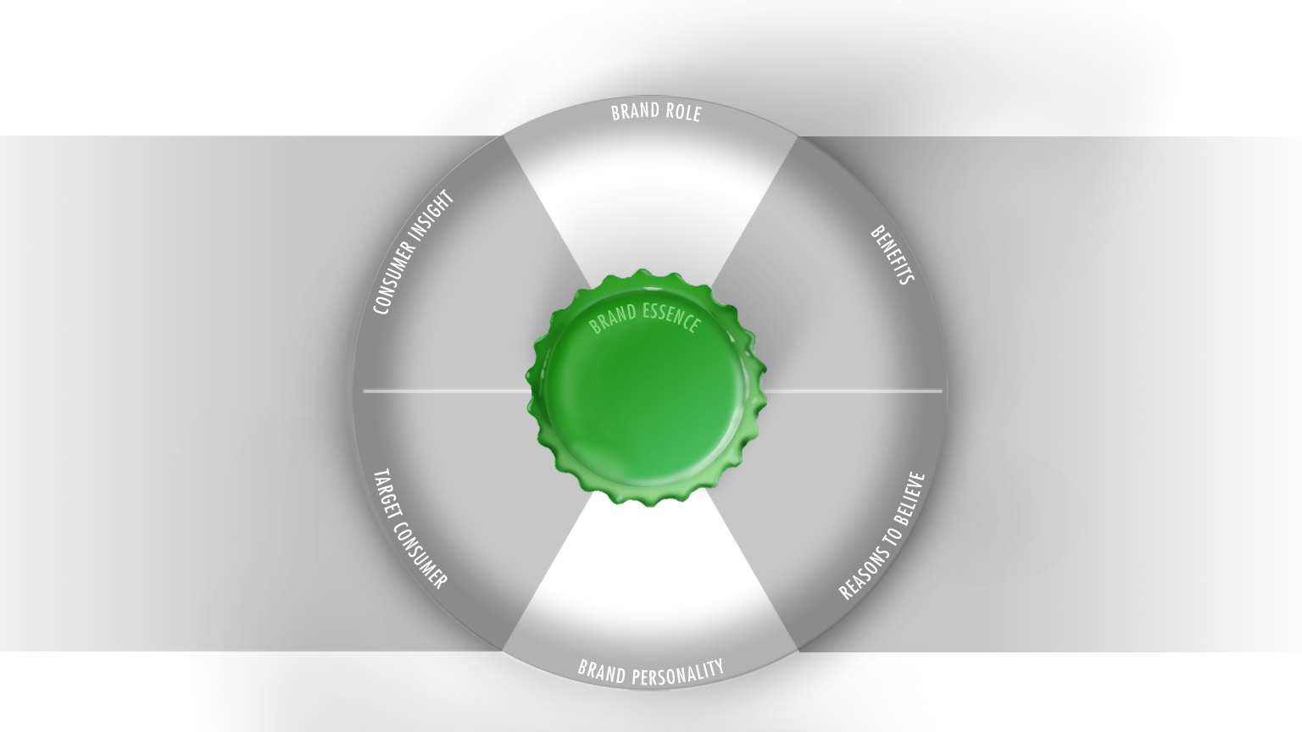




BRAND IN A BOTTLE
Consumer inspired >
The unique role the brand plays in the
life of its target consumer
< Brand led
A compelling
statement that
captures the heart of target consumer’s
motivations.
The
differentiating
functional,
emotional or
social benefits
that motivate
purchase.
Relevant
Consumer Insight
The distillation of what the Brand stands for
Credible
Brand DNA
The who, why
and when we
target with
our brand.
The facts
about the
brand that
give the autho-
rity to claim the
benefits
The
Aspirational personified characteristics of
the brand
Distinctive
Notes:
Brand in a Bottle: the new brand positioning framework in Heineken. Consumer Inspired and Brand Led is at the heart of our Bottle. Consumer on the left side… brand on the right side.
And where they meet, there is fire, it sparks’. It’s called Brand Essence, which captures the vision for the brand. This is the part where we elevate the Brand.
It is the vision for the brand that should be relevant for consumers, credible for that brand only, and distinctive versus competitors.
1

